Slide 1


Restaurant System
Project in java
By : Hossam elzoghpy

Slide 2
Outlines
Define project and the purpose of it.
The requirements that used in it.
Functions
Design
Database
Coding
Question

Slide 3
Define project and the purpose of it.
The project is Restaurant system used to serving the client for manage his restaurant and service his customer for buying meals and drinks

Slide 4
The requirements that used in it
Languages : java , javafx , sql
Software :Netbeans IDE V8.2 for : java and conntect to javafx and my sql, XAMPP control panel V3.2.2 for: server , php my admin for : queries of sql ,Scene builder for:GUI
Database : MYSQL

Slide 5
Functions:
Register
Sign in
Add meal
Delete meal
Modify meal
Empty form
Search about meal
Add drink
Delete drink
Modify drink
Search about drink
Log out
Exit

Slide 6

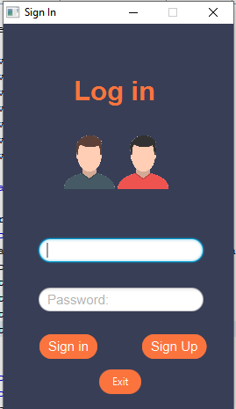



Design of project
(Log IN)

Slide 7
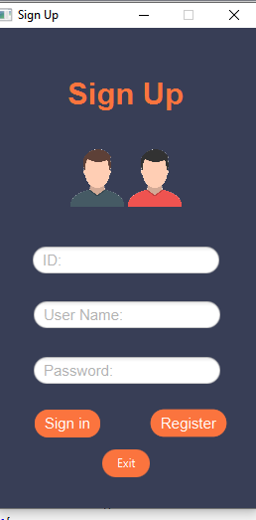
Sign Up

Slide 8
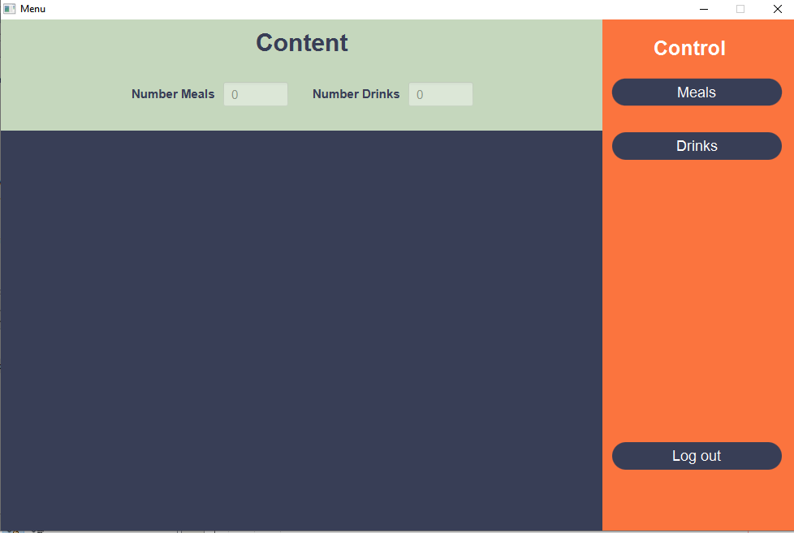
Main Menu

Slide 9
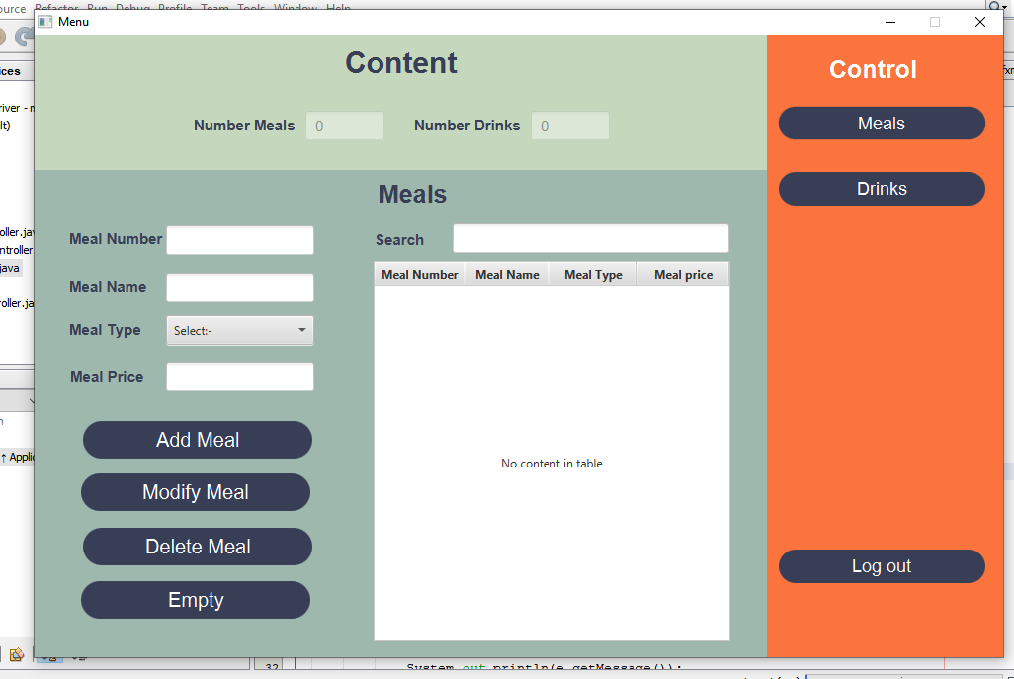
Meals

Slide 10
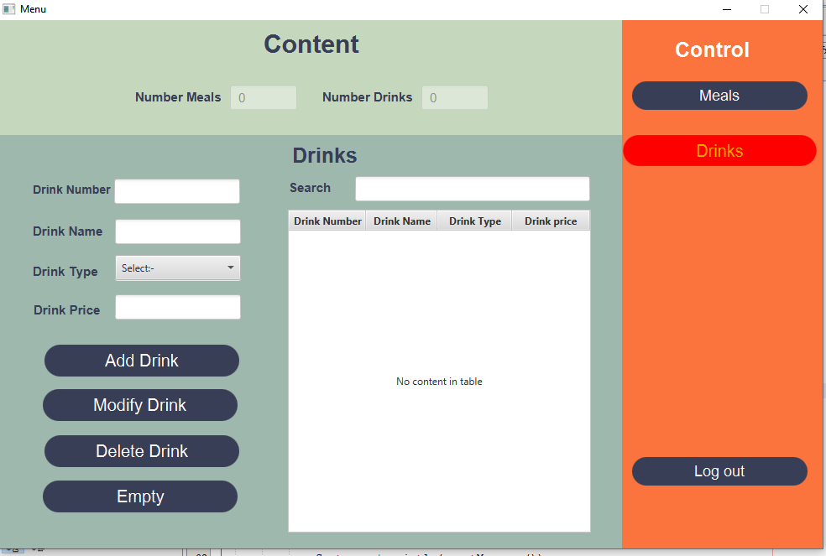
Drinks

Slide 11
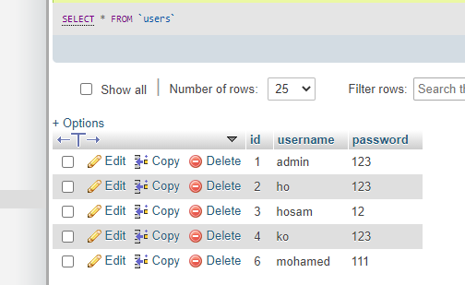
Database
(tables)
Table of user that content:
→ID
→username
→password

Slide 12
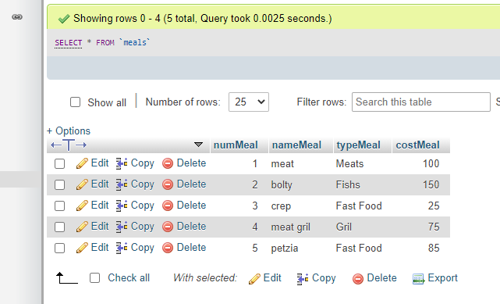
Database
(tables)
Table of Meals that content:
→number of meal
→name of meal
→type of meal
→cost of meal

Slide 13
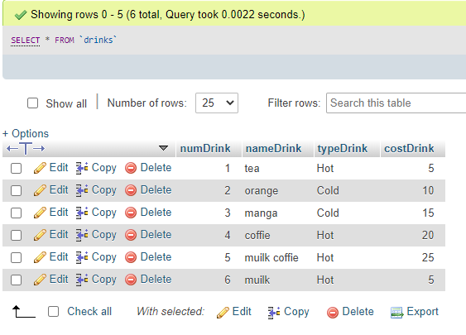
Database
(tables)
Table of Drinks that content:
→number of drink
→name of drink
→type of drink
→cost of drink

Slide 14
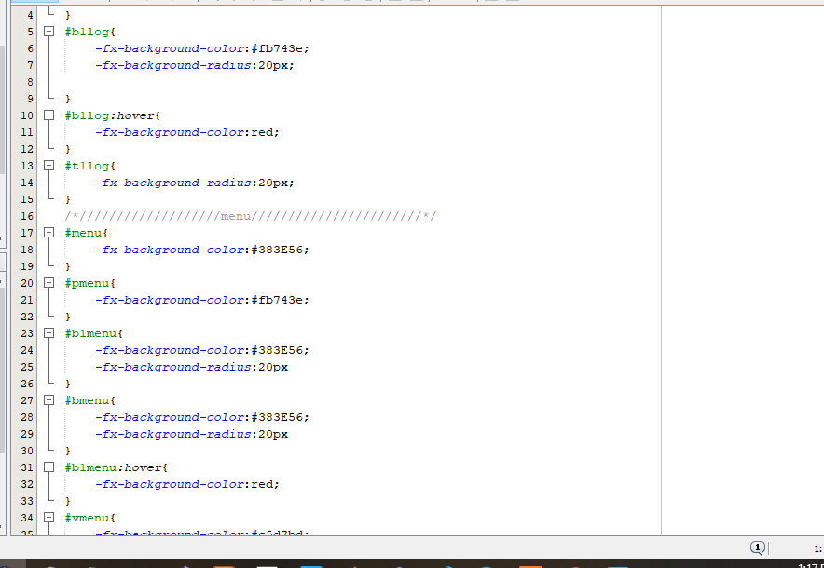
CSS

Slide 15
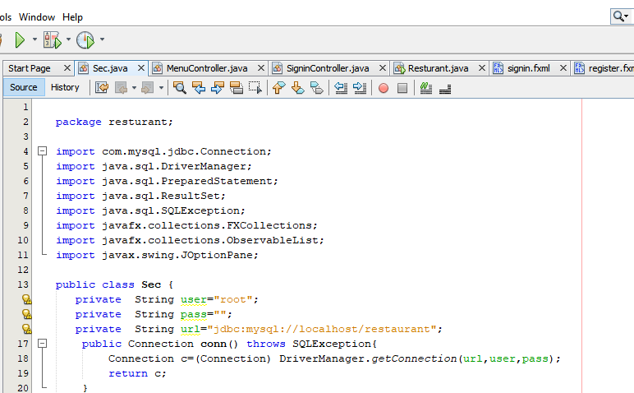
Coding:
Name of DB: restaurant
Host :localhost
Driver manager :MYSQL JDBC Driver
User :root

Slide 16
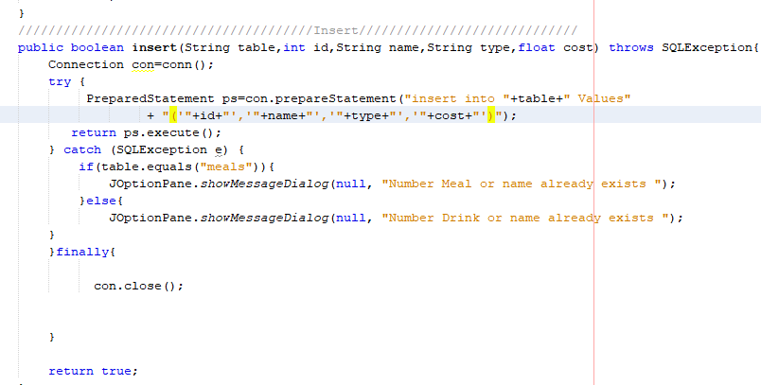
Insert In DB
Number of meal or drink → id
Name of meal or drink →name
Type of meal or drink → type
Cost of meal or drink → cost

Slide 17
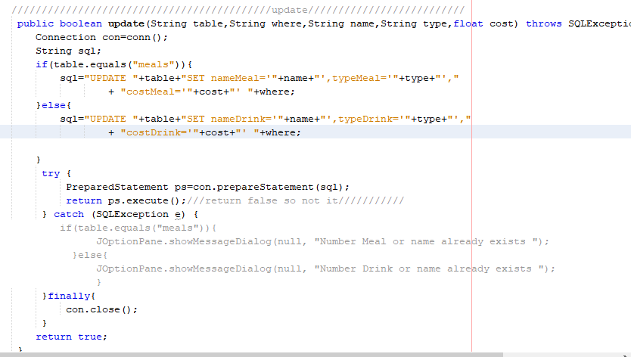
Update
Updating data using id

Slide 18
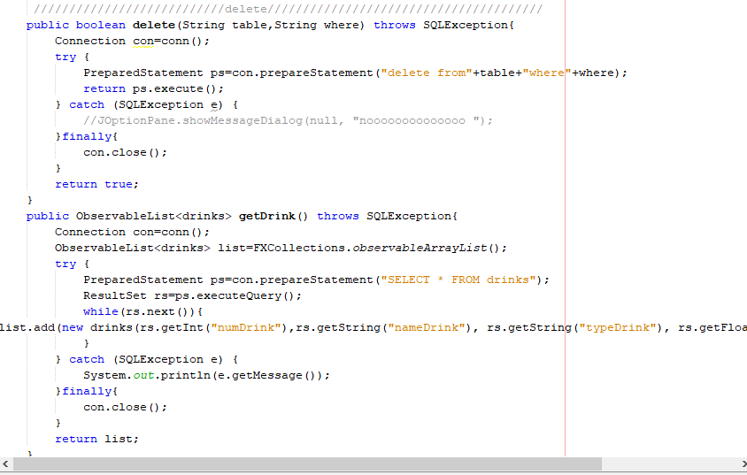
Delete in DB
Delete data using id

Slide 19
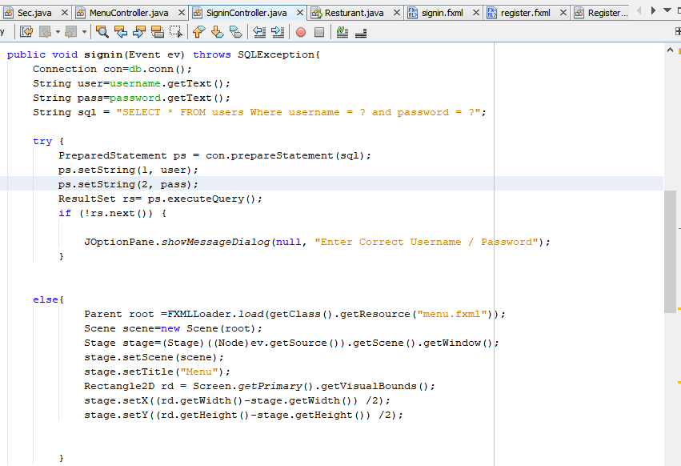
Button sign in
Take and check username and password from DB

Slide 20
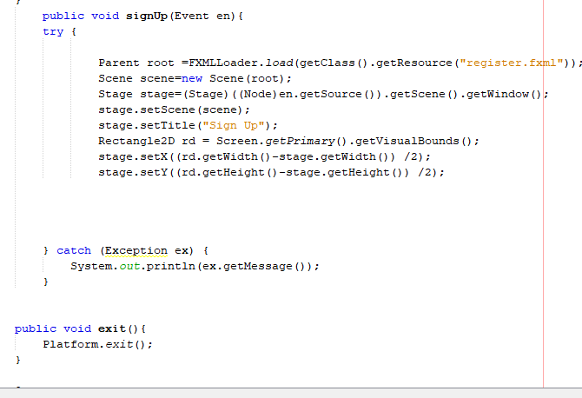
Button sign up
Go to the stage of sign up for registration

Slide 21
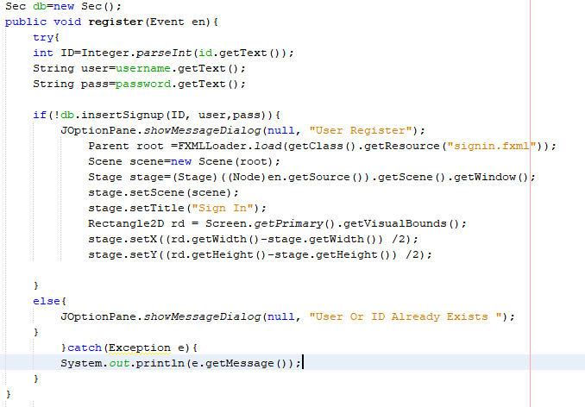
Button register
Insert the id , username , password in DB to make the user access in project

Slide 22
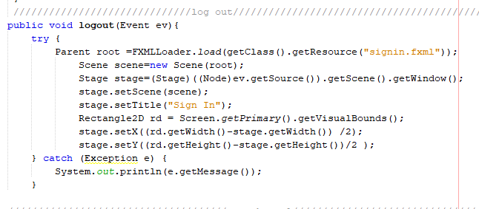
Button log out
Make user to return to the stage of sign in

Slide 23
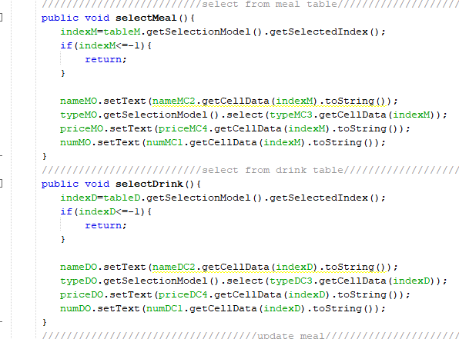
Select from table
When you choose a specific meal or drink from table a variable take the index for making changes in the meal or drink which you choose

Slide 24
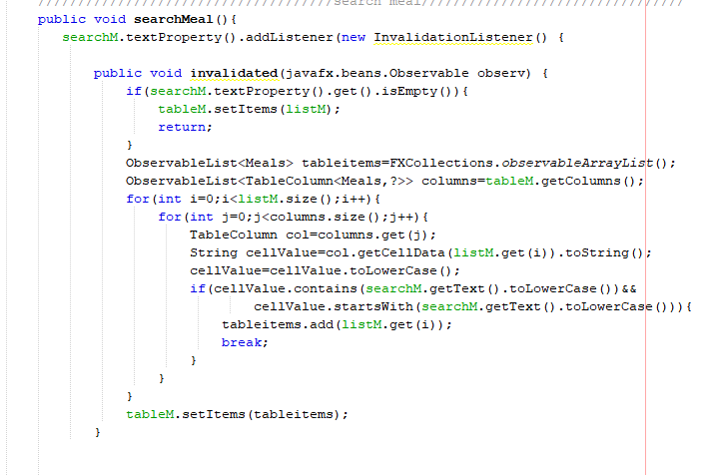
Searching
You can easily search about meal or drink by using number or name or cost or type

Slide 25
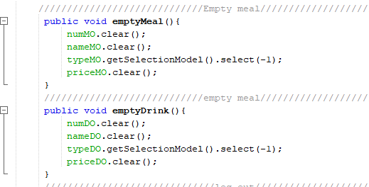
Empty form
By this function you can empty the form from data

Slide 26

Question:-

